Slide 1


Domestic Building Electrical Wiring
Imtiaz Hussain
ID- 21108001

Slide 2
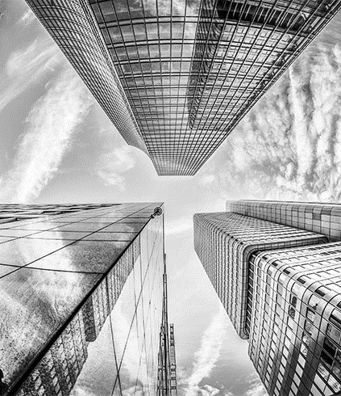
Floor Plan
Civil Drawing
Electrical Wiring
SDB Connection
MDB Connection
Key Points

Slide 3

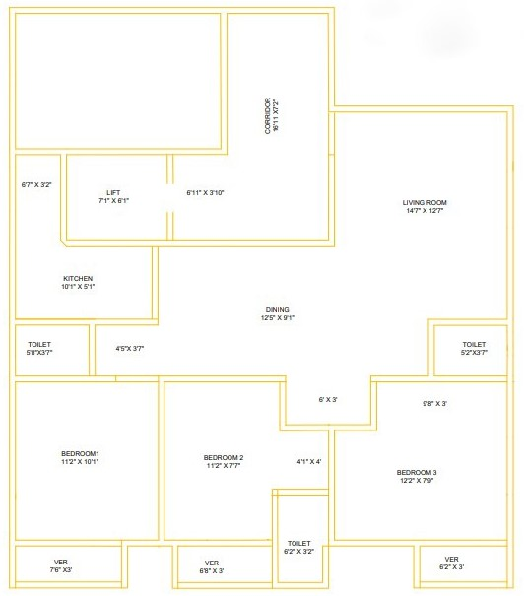
Floor Plan

Slide 4

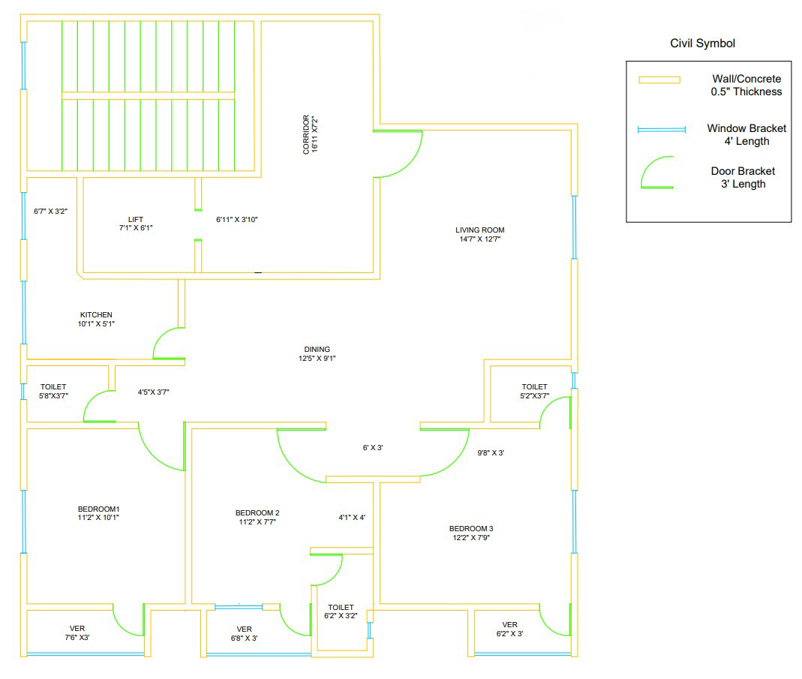
Civil Drawing
Approx. : 1192 Sqft

Slide 5
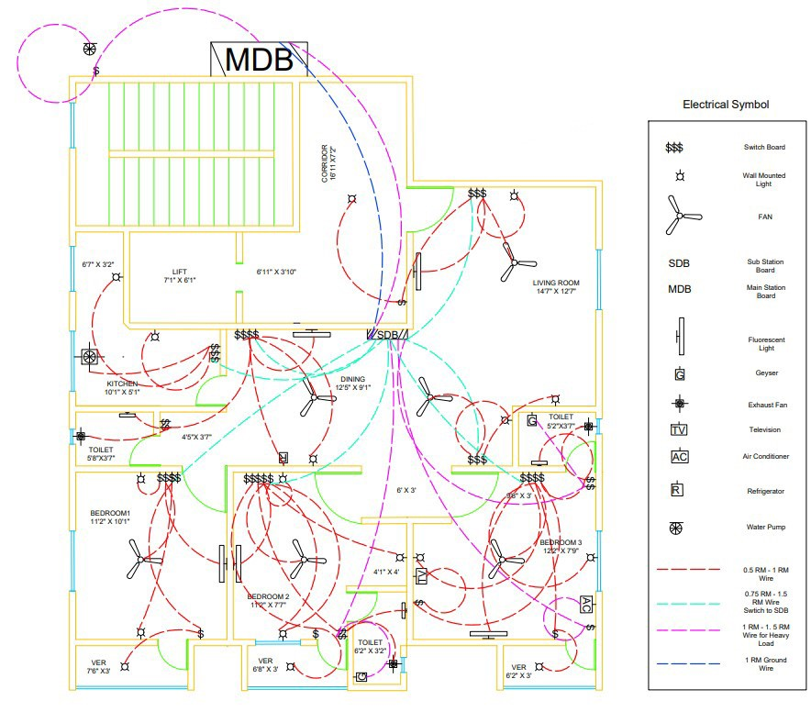
Electrical Wiring

Slide 6

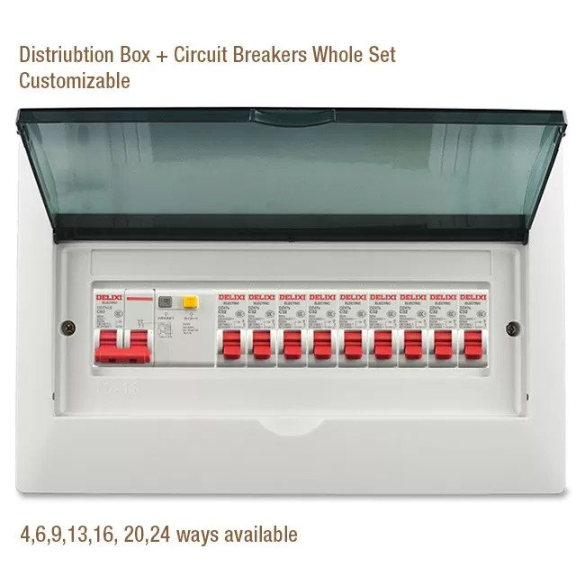
SDB to Floor Connection

Slide 7
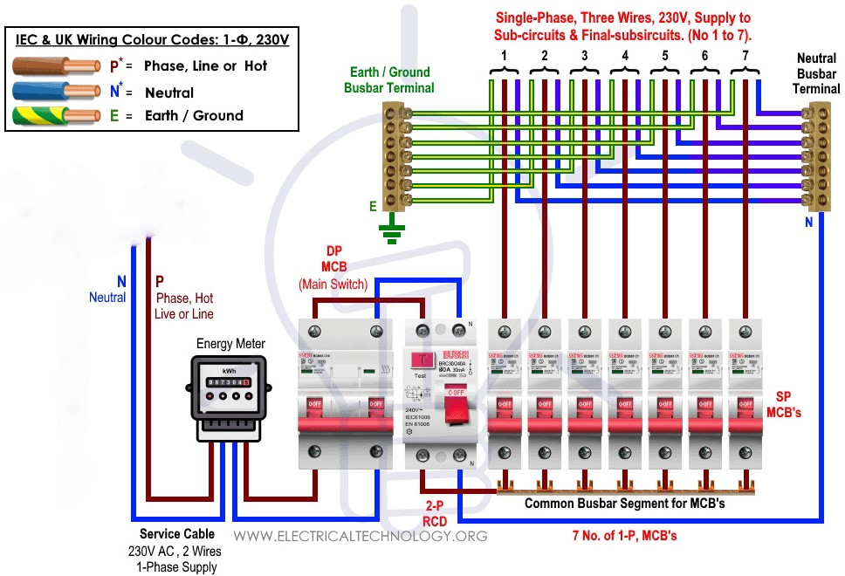
MDB to SDB Connection

Slide 8
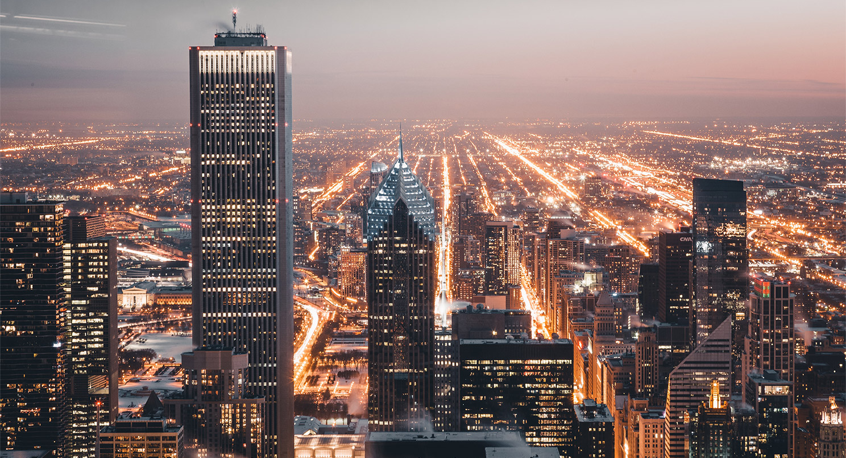
Thank You!

